Slide 1
Hooks
Salman Ahmed G

Slide 2
TOPICS
What are Hooks?
Why Hooks?
What is useState?
What is useEffect?
What is useContext?
What is useReducer?
What is useCallback?
What is useRef?

Slide 3
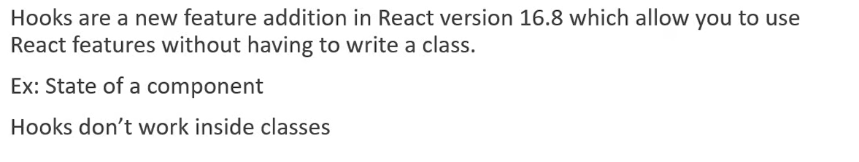
What are Hooks?

Slide 4
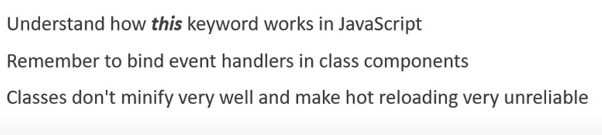
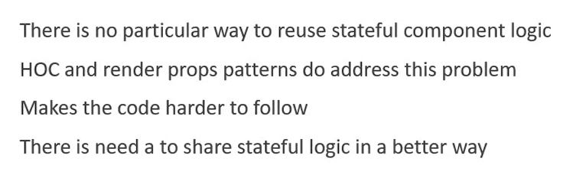
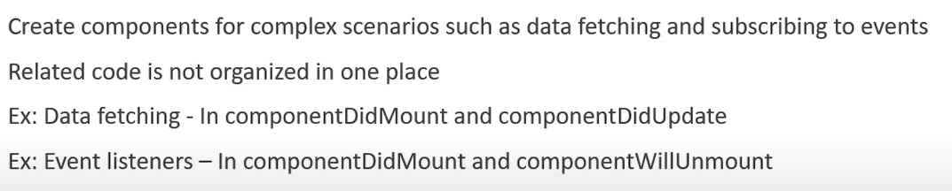
Why hooks?

Slide 5
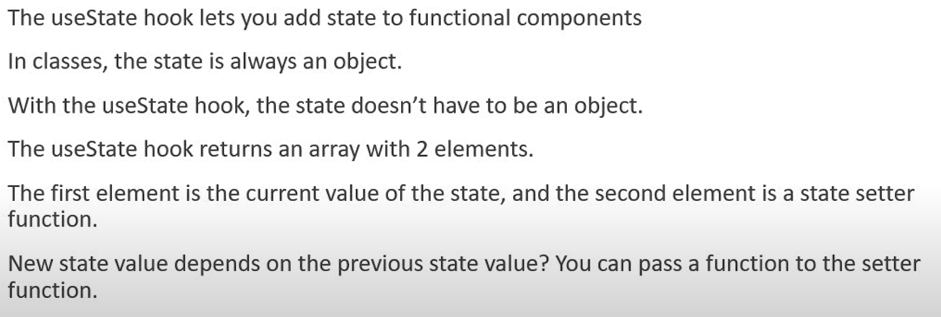
Usestate description

Slide 6
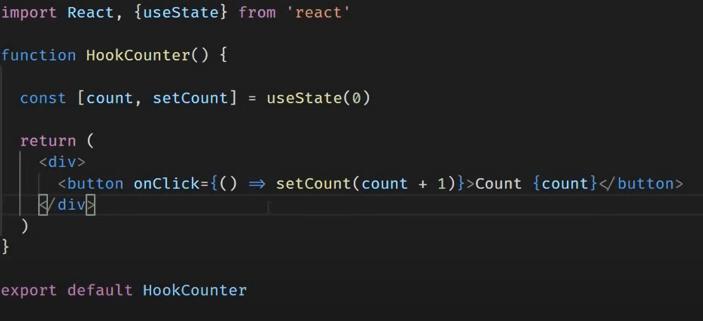
Usestate example

Slide 7
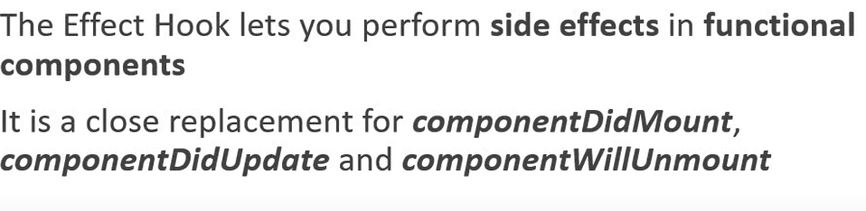
Useeffects benefits

Slide 8
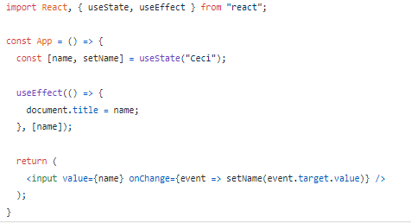
Useeffects change of state

Slide 9
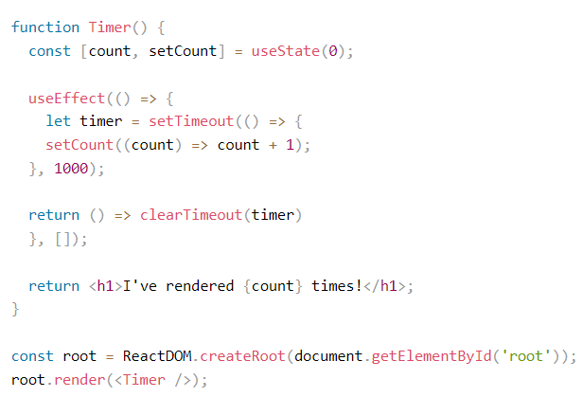
Useeffects cleanup

Slide 10
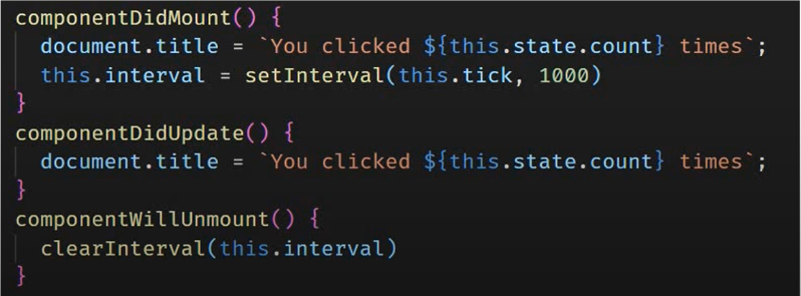
Useeffects compare to class component

Slide 11
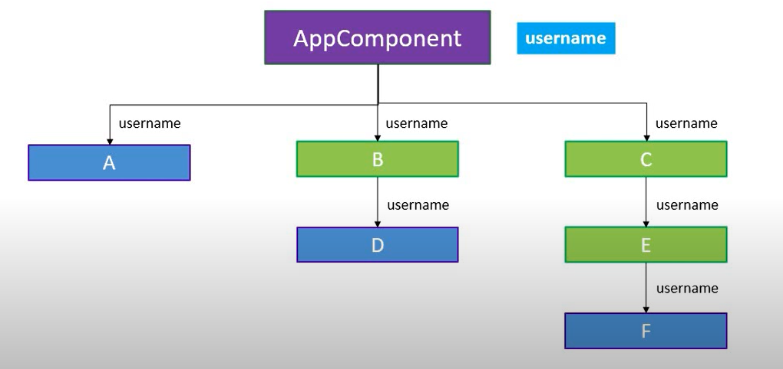
usecontext

Slide 12
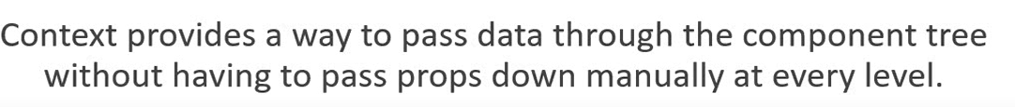
USECONTEXT

Slide 13
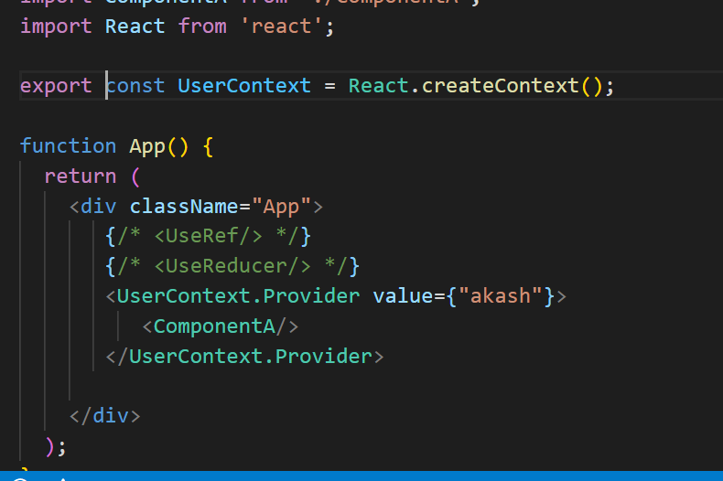
USECONTEXT EXAMPLE

Slide 14
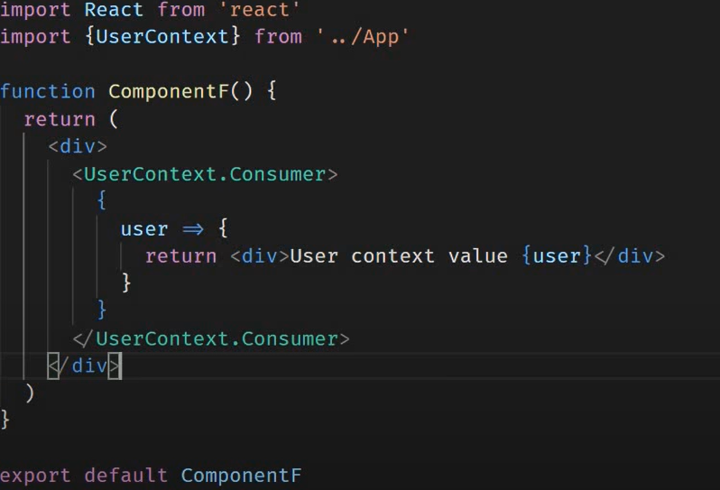
USECONTEXT EXAMPLE

Slide 15
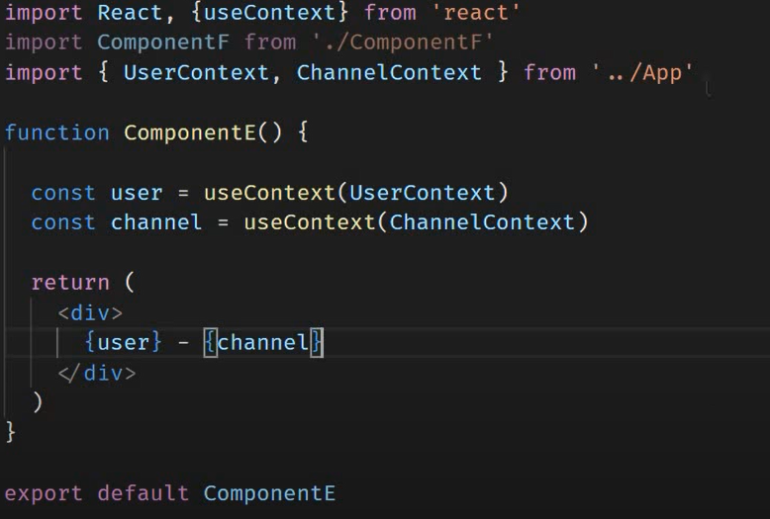
USECONTEXT

Slide 16
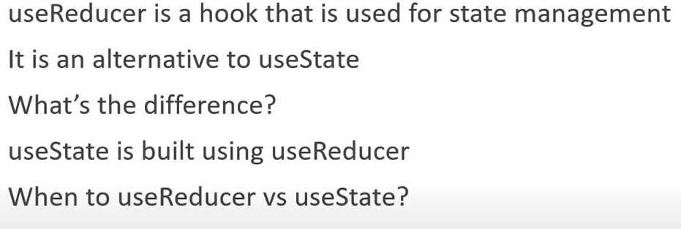
usereducers

Slide 17
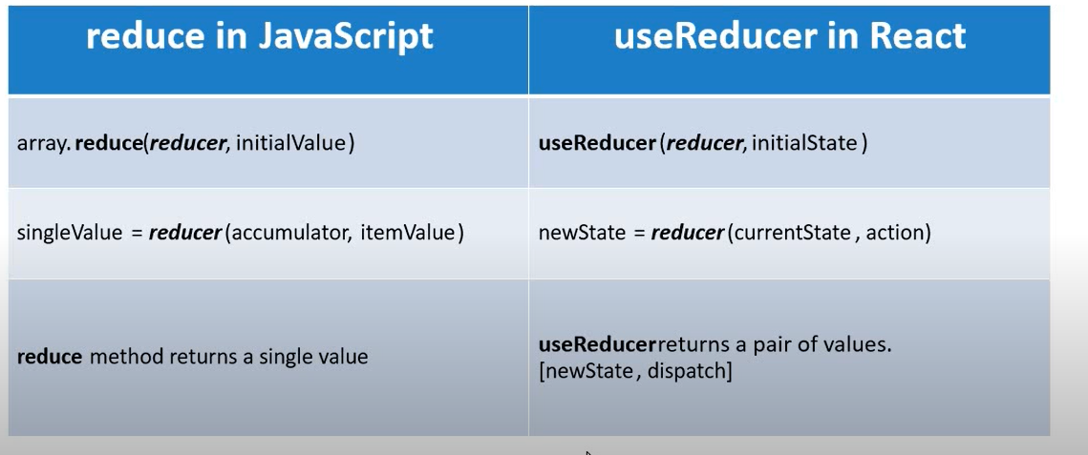
difference

Slide 18
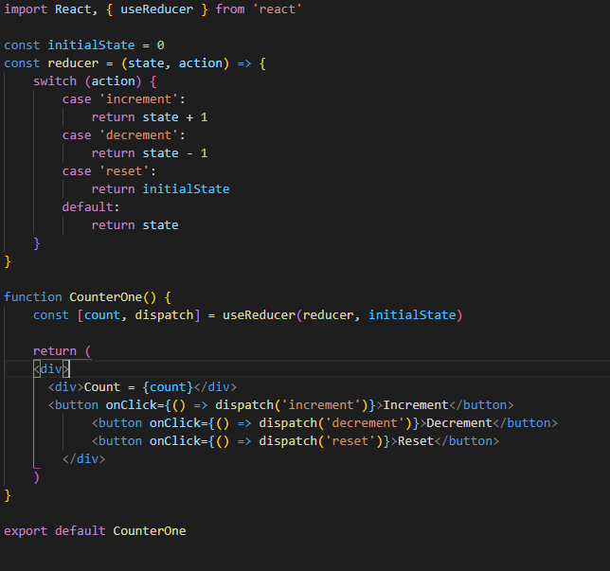
usereducers

Slide 19
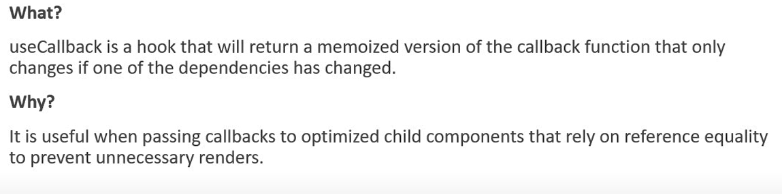
usecallback

Slide 20
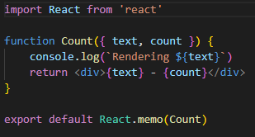
Usecallback - memo

Slide 21
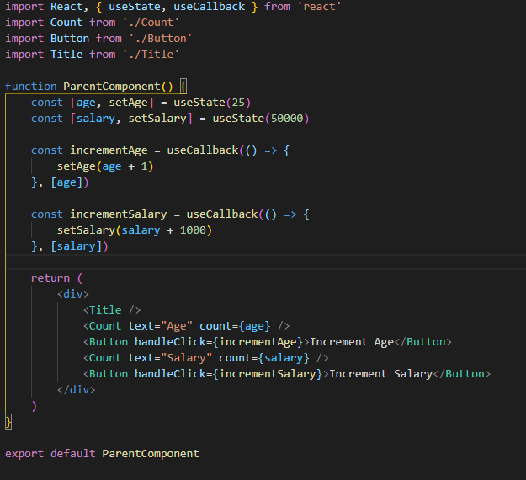
Usecallback

Slide 22
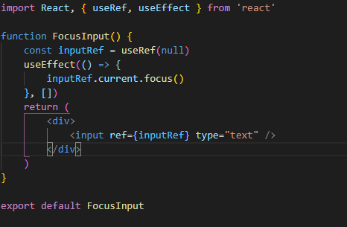
useref

